Slide 1

SRM INSTITUTE OF SCIENCE AND TECHNOLOGY,
RAMAPURAM CAMPUS
Unit - IV
Support Vector Machines and
Artificial Neural Networks

Slide 2
Unit IV
Support Vector Machines
Support vector machines working principles
Maximum margin classifier
Support vector classifier
Support vector machines
Kernel functions
Artificial Neural Networks
Forward propagation and back propagation
Optimization of neural networks
Stochastic gradient descent - SGD
Introduction to deep learning
Solving methodology
Deep learning software

Slide 3
Support Vector Machines
Support vector machines (SVMs) are a set of supervised learning methods used for classification, regression and outliers detection.
A support vector machine (SVM) can be imagined as a surface that maximizes the boundaries between various types of points of data that is represent in multidimensional space, also known as a hyperplane, which creates the most homogeneous points in each subregion.
Support vector machines can be used on any type of data, but have special extra advantages for data types with very high dimensions relative to the observations.
For example:
Text classification, in which language has the very dimensions of word vectors
For the quality control of DNA sequencing by labeling chromatograms correctly

Slide 4

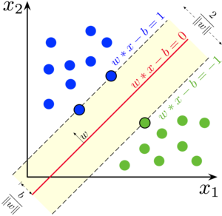
Support Vector Machines

Slide 5
Support Vector Machines
Support vector machines working principles
Support vector machines are mainly classified into three types based on their working principles:
Maximum margin classifiers
Support vector classifiers
Support vector machines

Slide 6
Support Vector Machines
Maximum margin classifier
It is feasible to draw infinite hyperplanes to classify the same set of data
But to consider as an ideal hyperplane, The maximum margin classifier considers the hyperplane with the maximum margin of separation width.
Hyperplanes:
In n- dimensional space, a hyperplane is a flat affine subspace of dimension n-1.
In 2- dimensional space, the hyperplane is a straight line which separates the 2-dimensional space into two halves.
The hyperplane is defined by the following equation.
Points which lay on the hyperplane have to follow the above equation.

Slide 7
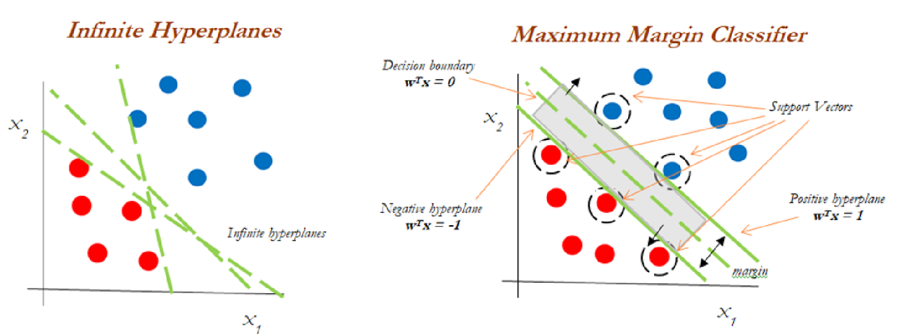
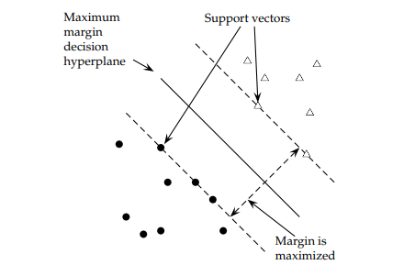
Support Vector Machines

Slide 8
Support Vector Machines
However, there are regions above and below as well. This means observations could fall in either of the regions, also called the region of classes

Slide 9
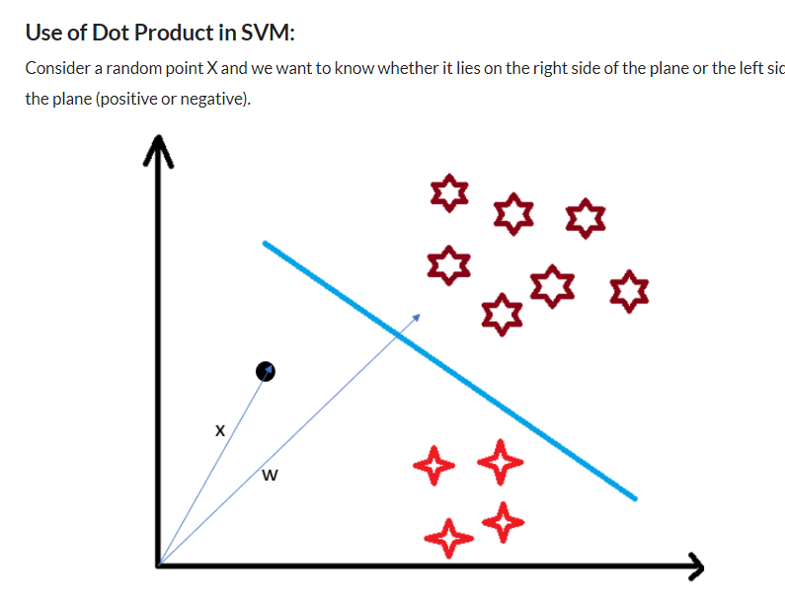
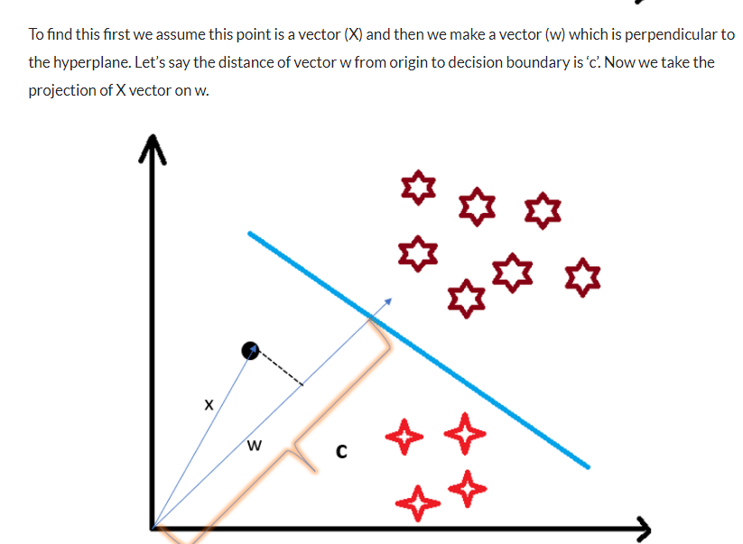
Support Vector Machines

Slide 10
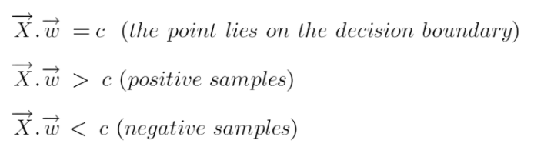
Support Vector Machines
We already know that projection of any vector or another vector is called dot-product. Hence, we take the dot product of x and w vectors. If the dot product is greater than ‘c’ then we can say that the point lies on the right side. If the dot product is less than ‘c’ then the point is on the left side and if the dot product is equal to ‘c’ then the point lies on the decision boundary.

Slide 11
Support Vector Machines
why did we take this perpendicular vector w to the hyperplane?
So what we want is the distance of vector X from the decision boundary and there can be infinite points on the boundary to measure the distance from. So that’s why we come to standard, we simply take perpendicular and use it as a reference and then take projections of all the other data points on this perpendicular vector and then compare the distance.

Slide 12
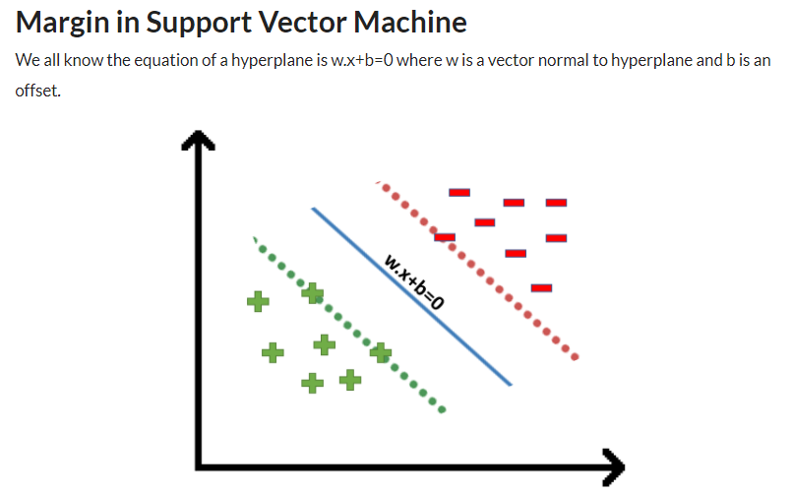
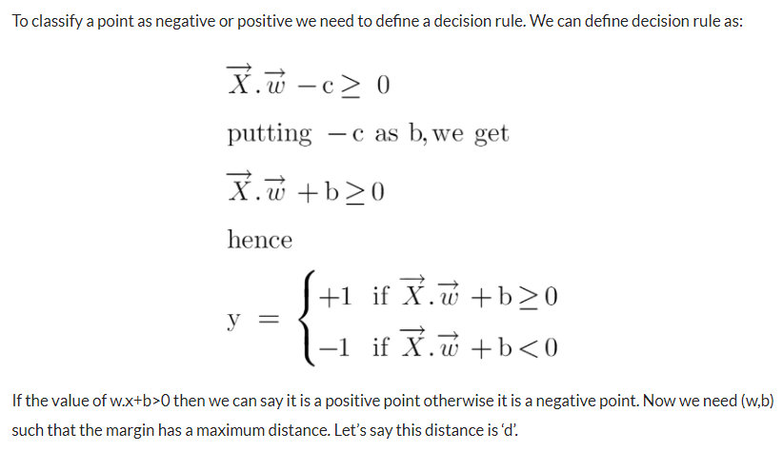
Support Vector Machines

Slide 13
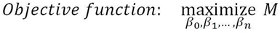
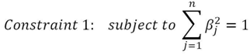
Support Vector Machines
The mathematical representation of the maximum margin classifier is as follows, which is an optimization problem
Constraint 2 ensures that observations will be on the correct side of the hyperplane by taking the product of coefficients with x variables and finally, with a class variable indicator.

Slide 14
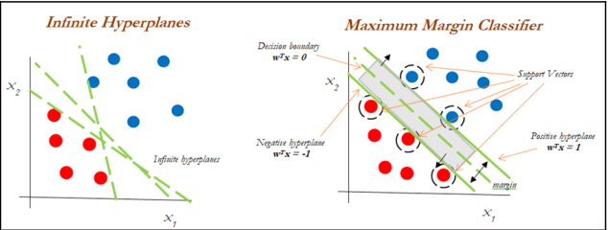
Support Vector Machines
Infinite separate hyperplanes can be drawn to separate the two classes (blue and red).
However, the maximum margin classifier attempts to fit the widest slab (maximize the margin between positive and negative hyperplanes) between two classes and the observations touching both the positive and negative hyperplanes called support vectors:
Classifier performance purely depends on the support vectors and any changes to observation values which are not support vectors do not impact any change in the performance of the Maximum Margin Classifier, as only extreme points are considered in the algorithm.

Slide 15
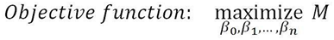
Support Vector Machines
Support vector classifier
Support vector classifiers are an extended version of maximum margin classifiers, in which some violations are tolerated for non-separable cases in order to create the best fit, even with slight errors within the threshold limit.
In fact, in real-life scenarios, we hardly find any data with purely separable classes; most classes have a few or more observations in overlapping classes.
The mathematical representation of the support vector classifier is as follows, a slight correction to the constraints to accommodate error terms

Slide 16
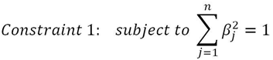
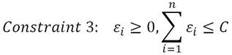
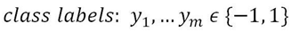
Support Vector Machines
Support vector classifier
The mathematical representation of the support vector classifier is as follows, a slight correction to the constraints to accommodate error terms
In constraint 3, the C value is a non-negative tuning parameter to either accommodate more or fewer overall errors in the model.

Slide 17
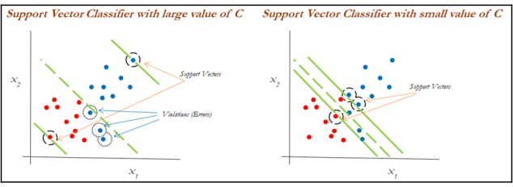
Support Vector Machines
Support vector classifier
C is a tuning parameter in Support Vector Classifiers
The impact of changing the C value on margins is shown in the following diagram:
High value of C - the model would be more tolerating and also have space for violations (errors) in the left diagram,
Lower value of C, - no scope for accepting violations leads to a reduction in margin width.

Slide 18
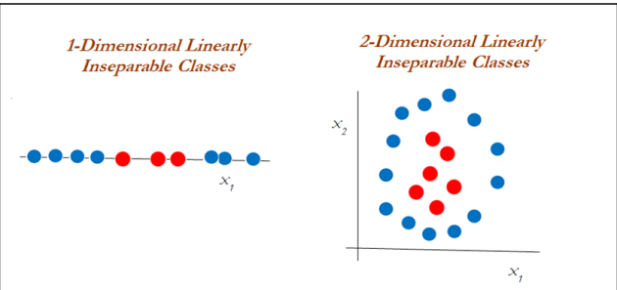
Support Vector Machines
Support vector machines
Support vector machines are used when the decision boundary is non-linear and would not be separable with support vector classifiers whatever the cost function is.
The following diagram explains the non-linearly separable cases for both 1-dimension and 2-dimensions
We need to use another way of handling the data, called the kernel trick, using the kernel function to work with non-linearly separable data.

Slide 19
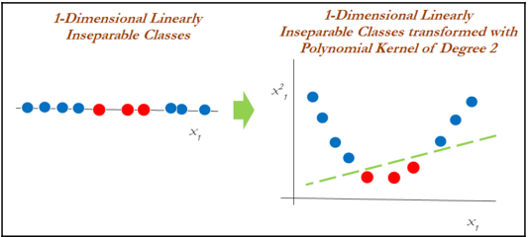
Support Vector Machines
Support vector machines
A polynomial kernel with degree 2 has been applied in transforming the data from 1-dimensional to 2-dimensional data.
In the left diagram, different classes (red and blue) are plotted on X1 only, whereas after applying degree 2, we now have 2- dimensions, X1 and X²1 (the original and a new dimension).
The degree of the polynomial kernel is a tuning parameter;
the practitioner needs to tune them with various values to check where higher accuracies are possible with the model:

Slide 20
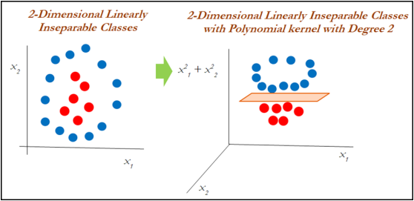
Support Vector Machines
Support vector machines
In the 2-dimensional case, the kernel trick is applied with the polynomial kernel with degree 2.
It seems that observations have been classified successfully using a linear plane after projecting the data into higher dimensions:

Slide 21
Support Vector Machines
Kernel functions
Kernel functions are the functions that, given the original feature vectors, return the same value as the dot product of its corresponding mapped feature vectors.
The main reason for using kernel functions is to eliminate the computational requirement to derive the higher-dimensional vector space from the given basic vector space, so that observations be separated linearly in higher dimensions.
Need - The derived vector space will grow exponentially with the increase in dimensions and it will become almost too difficult to continue computation, even when you have a variable size of 30 or so.

Slide 22
Support Vector Machines
Kernel functions
Example - shows how the size of the variables grows
When we have two variables such as x and y, with a polynomial degree kernel, it needs to compute x², y², and xy dimensions in addition.
Whereas, if we have three variables x, y, and z, then we need to calculate the x², y², z², xy, yz, xz, and xyz vector spaces.
The increase of one more dimension creates so many combinations. Hence, care needs to be taken to reduce its computational complexity;
Thus Kernels are used and defined more formally in the following equation:

Slide 23
Support Vector Machines
Kernel functions
Polynomial Kernel:
Polynomial kernels are popularly used, especially with degree 2.
In fact, the inventor of support vector machines, Vladimir N Vapnik, developed using a degree 2 kernel for classifying handwritten digits.
Polynomial kernels are given by the following equation:
For reference : SVM | Support Vector Machine Algorithm in Machine Learning (analyticsvidhya.com)

Slide 24
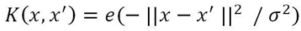
Support Vector Machines
Kernel functions
Radial Basis Function (RBF) / Gaussian Kernel:
RBF kernels are a good first choice for problems requiring nonlinear models.
A decision boundary that is a hyperplane in the mapped feature space is similar to a decision boundary that is a hypersphere in the original space.
The feature space produced by the Gaussian kernel can have an infinite number of dimensions, a feat that would be impossible otherwise. RBF kernels are represented by the following equation
This is often simplified as the following equation:

Slide 25
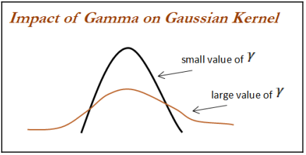
Support Vector Machines
Kernel functions
When the value of the gamma value is small, it gives you a pointed bump in the higher dimensions; a larger value gives you a softer, broader bump.
A small gamma will give you low bias and high variance solutions;
a high gamma will give high bias and low variance solutions

Slide 26
Support Vector Machines
SVM multilabel classifier with letter recognition data example
Dataset : https://archive.ics.uci.edu/ml/datasets/letter+recognition.
The task is to identify each of a large number of black and white rectangular pixel displays as one of the 26 capital letters in the English alphabet (from A to Z; 26 classes altogether) based on a few characteristics in integers, such as x-box (horizontal position of box), y-box (vertical position of box), width of the box, height of the box, and so on:
>>> import os
""" First change the following directory link to where all input files do exist """
>>> os.chdir("D:\\Book writing\\Codes\\Chapter 6")
>>> import pandas as pd
>>> letterdata = pd.read_csv("letterdata.csv")
>>> print (letterdata.head())

Slide 27
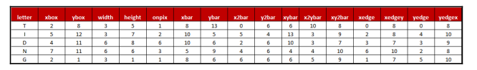
Support Vector Machines
SVM multilabel classifier with letter recognition data example
Following code is used to remove the target variable from x variables and at the same time
create new y variable for convenience:
>>> x_vars = letterdata.drop(['letter'],axis=1)
>>> y_var = letterdata["letter"]

Slide 28
Support Vector Machines
SVM multilabel classifier with letter recognition data example
As scikit-learn does not directly support characters, we need to convert them into number mappings. Here, we have done so with the dictionary:
>>> y_var = y_var.replace({'A':1,'B':2,'C':3,'D':4,'E':5,'F':6,'G':7, 'H':8,'I':9, 'J':10,'K':11,'L':12,'M':13,'N':14,'O':15,'P':16,'Q':17,'R':18,'S':19,'T':2 0,'U':21, 'V':22, 'W':23,'X':24,'Y':25,'Z':26})
>>> from sklearn.metrics import accuracy_score,classification_report
>>> from sklearn.model_selection import train_test_split
>>> x_train,x_test,y_train,y_test = train_test_split(x_vars,y_var,train_size = 0.7,random_state=42)
# Linear Classifier
>>> from sklearn.svm import SVC

Slide 29
Support Vector Machines
Maximum margin classifier - linear kernel
The following code shows a linear classifier (also known as a maximum margin classifier)
with cost value as 1.0:
>>> svm_fit = SVC(kernel='linear',C=1.0,random_state=43)
>>> svm_fit.fit(x_train,y_train)
>>> print ("\nSVM Linear Classifier - Train Confusion Matrix\n\n",
pd.crosstab(y_train, svm_fit.predict(x_train),rownames = ["Actuall"],colnames = ["Predicted"]) )
>>> print ("\nSVM Linear Classifier - Train accuracy:",round(accuracy_score(y_train, svm_fit.predict(x_train)),3))
>>> print ("\nSVM Linear Classifier - Train Classification Report\n",
classification_report(y_train,svm_fit.predict(x_train)))

Slide 30
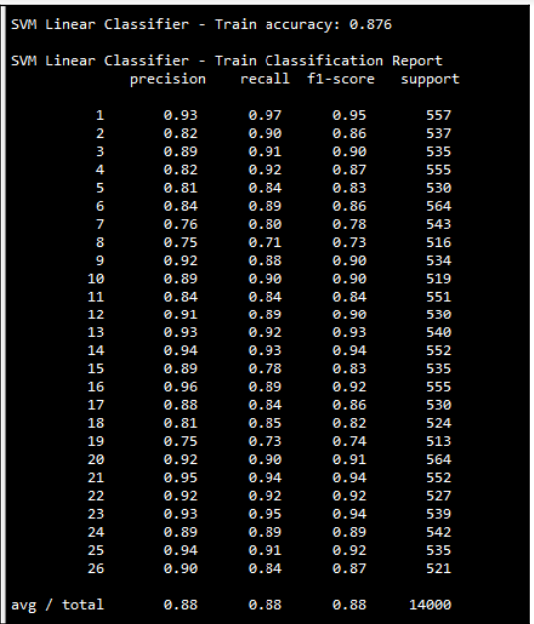
Support Vector Machines
Maximum margin classifier - linear kernel

Slide 31
Support Vector Machines
Maximum margin classifier - linear kernel
Following code used for printing the test accuracy values:
>>> print ("\n\nSVM Linear Classifier - Test Confusion
Matrix\n\n",pd.crosstab(y_test, svm_fit.predict(x_test),rownames =
["Actuall"],colnames = ["Predicted"]))
>>> print ("\nSVM Linear Classifier - Test accuracy:",round(accuracy_score(
y_test,svm_fit.predict(x_test)),3))
>>> print ("\nSVM Linear Classifier - Test Classification Report\n",
classification_report(y_test,svm_fit.predict(x_test)))

Slide 32
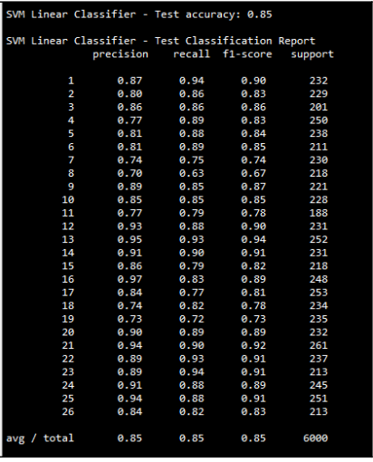
Support Vector Machines
Maximum margin classifier - linear kernel
From the above results, we can see that test accuracy for the linear classifier is 85%

Slide 33
Support Vector Machines
Polynomial kernel
A polynomial kernel with degree of 2 has been used to check whether any improvement in accuracy is possible.
The cost value has been kept constant with respect to the linear classifier in order to determine the impact of the non-linear kernel:
#Polynomial Kernel
>>> svm_poly_fit = SVC(kernel='poly',C=1.0,degree=2)
>>> svm_poly_fit.fit(x_train,y_train)
>>> print ("\nSVM Polynomial Kernel Classifier - Train Confusion Matrix\n\n",pd.crosstab(y_train,svm_poly_fit.predict(x_train),rownames = ["Actuall"],colnames = ["Predicted"]) )
>>> print ("\nSVM Polynomial Kernel Classifier - Train accuracy:",round(accuracy_score( y_train,svm_poly_fit.predict(x_train)),3))
>>> print ("\nSVM Polynomial Kernel Classifier - Train Classification Report\n", classification_report(y_train,svm_poly_fit.predict(x_train)))

Slide 34
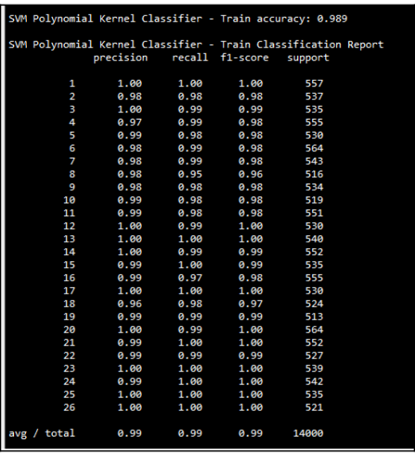
Support Vector Machines
Polynomial kernel

Slide 35
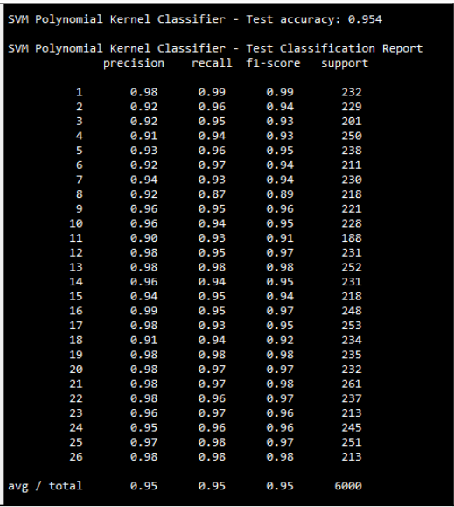
Support Vector Machines
Polynomial kernel
>>> print ("\n\nSVM Polynomial Kernel Classifier - Test Confusion Matrix\n\n", pd.crosstab(y_test,svm_poly_fit.predict(x_test),rownames = ["Actuall"],colnames = ["Predicted"]))
>>> print ("\nSVM Polynomial Kernel Classifier - Test accuracy:",round(accuracy_score( y_test,svm_poly_fit.predict(x_test)),3))
>>> print ("\nSVM Polynomial Kernel Classifier - Test Classification Report\n", classification_report(y_test,svm_poly_fit.predict(x_test)))

Slide 36
Support Vector Machines
RBF kernel
The cost value is kept constant with respective other kernels but the gamma value has been chosen as 0.1 to fit the model:
#RBF Kernel
>>> svm_rbf_fit = SVC(kernel='rbf',C=1.0, gamma=0.1)
>>> svm_rbf_fit.fit(x_train,y_train)
>>> print ("\nSVM RBF Kernel Classifier - Train Confusion
Matrix\n\n",pd.crosstab( y_train,svm_rbf_fit.predict(x_train),rownames = ["Actuall"],colnames = ["Predicted"]))
>>> print ("\nSVM RBF Kernel Classifier - Train accuracy:",round(accuracy_score( y_train, svm_rbf_fit.predict(x_train)),3))
>>> print ("\nSVM RBF Kernel Classifier - Train Classification Report\n", classification_report(y_train,svm_rbf_fit.predict(x_train)))

Slide 37
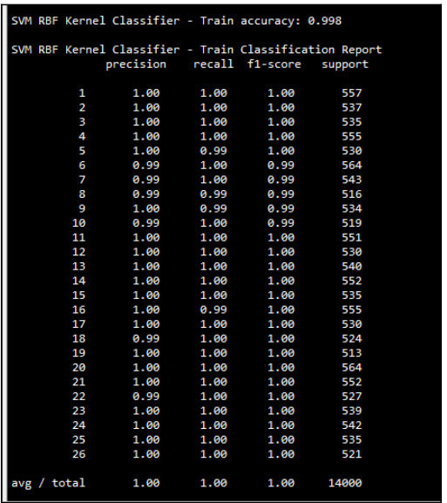
Support Vector Machines
RBF kernel

Slide 38
Support Vector Machines
RBF kernel
>>> print ("\n\nSVM RBF Kernel Classifier - Test Confusion Matrix\n\n",
pd.crosstab(y_test,svm_rbf_fit.predict(x_test),rownames =
["Actuall"],colnames = ["Predicted"]))
>>> print ("\nSVM RBF Kernel Classifier - Test accuracy:",round(
accuracy_score( y_test,svm_rbf_fit.predict(x_test)),3))
>>> print ("\nSVM RBF Kernel Classifier - Test Classification Report\n",
classification_report(y_test,svm_rbf_fit.predict(x_test)))

Slide 39
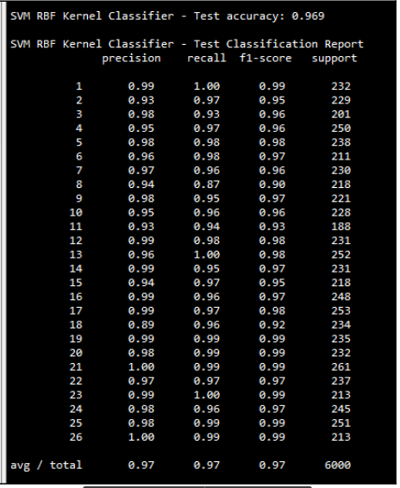
Support Vector Machines
RBF kernel

Slide 40
Artificial Neural Networks - ANN
Artificial neural networks (ANNs) model the relationship between a set of input signals and output signals using a model derived from a replica of the biological brain, which responds to stimuli from its sensory inputs.
The human brain consists of about 90 billion neurons, with around 1 trillion connections between them;
ANN methods try to model problems using interconnected artificial neurons (or nodes) to solve machine learning problems
In Human Brain
Incoming signals are received by the cell's dendrites through a biochemical process that allows the impulses to be weighted according to their relative importance.
As the cell body begins to accumulate the incoming signals, a threshold is reached, at which the cell fires and the output signal is then transmitted via an electrochemical process down the axon.
At the axon terminal, an electric signal is again processed as a chemical signal to be passed to its neighboring neurons, which will be dendrites to some other neuron.

Slide 41
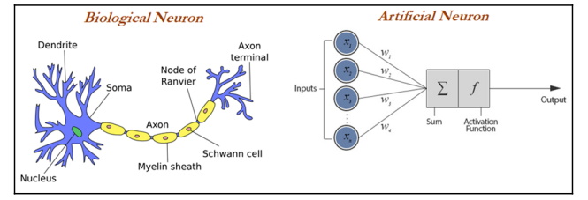
Artificial Neural Networks - ANN
A similar working principle is loosely used in building an artificial neural network, in which each neuron has a set of inputs, each of which is given a specific weight.
The neuron computes a function on these weighted inputs.
A linear neuron takes a linear combination of weighted input and applies an activation function (sigmoid, tanh, relu, and so on) on the aggregated sum.
The network feeds the weighted sum of the input into the logistic function (in case of sigmoid function).
The logistic function returns a value between 0 and 1 based on the set threshold; for example, here we set the threshold as 0.7.
Any accumulated signal greater than 0.7 gives the signal of 1 and vice versa; any accumulated signal less than 0.7 returns the value of 0:

Slide 42
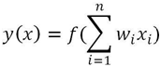
Artificial Neural Networks - ANN
A typical artificial neuron with n input dendrites can be represented by the following formula.
The w weights allow each of the n inputs of x to contribute a greater or lesser amount to the sum of input signals.
The accumulated value is passed to the activation function, f(x), and the resulting signal, y(x), is the output axon:

Slide 43
Artificial Neural Networks - ANN
The parameters required for choosing for building neural networks are the following:
Activation function: Choosing an activation function plays a major role in aggregating signals into the output signal to be propagated to the other neurons of the network.
Network architecture or topology: This represents the number of layers required and the number of neurons in each layer. More layers and neurons will create a highly non-linear decision boundary, whereas if we reduce the architecture, the model will be less flexible and more robust.
Training optimization algorithm: The selection of an optimization algorithm plays a critical role as well, in order to converge quickly and accurately to the best optimal solutions
Applications of Neural Networks:
Images and videos: To identify an object in an image or to classify whether it is a dog or a cat
Text processing (NLP): Deep-learning-based chatbot and so on
Speech: Recognize speech
Structured data processing: Building highly powerful models to obtain a non-linear decision boundary

Slide 44
Artificial Neural Networks - ANN
Activation functions
Activation functions are the mechanisms by which an artificial neuron processes information and passes it throughout the network.
The activation function takes a single number and performs a certain fixed mathematical functional mapping on it.
Different types of activation functions are :
Sigmoid function: Sigmoid has the mathematical form σ(x) = 1 / (1+e−x). It takes a real- valued number and squashes it into a range between 0 and 1. Sigmoid is a popular choice, which makes calculating derivatives easy and is easy to interpret.
Tanh function: Tanh squashes the real-valued number into the range [-1, 1]. The output is zero-centered. In practice, tanh non-linearity is always preferred to sigmoid non-linearity. Also, it can be proved that tanh is scaled sigmoid neuron tanh(x) = 2σ (2x) − 1.
Rectified Linear Unit (ReLU) function: ReLU has become very popular in the last few years. It computes the function f(x) = max (0, x). Activation is simply thresholds at zero.
Linear function: The linear activation function is used in linear regression problems, where it always provides a derivative as 1 due to the function used being f(x) = x.
Relu is now popularly being used in place of Sigmoid or Tanh due to its better convergence property.

Slide 45
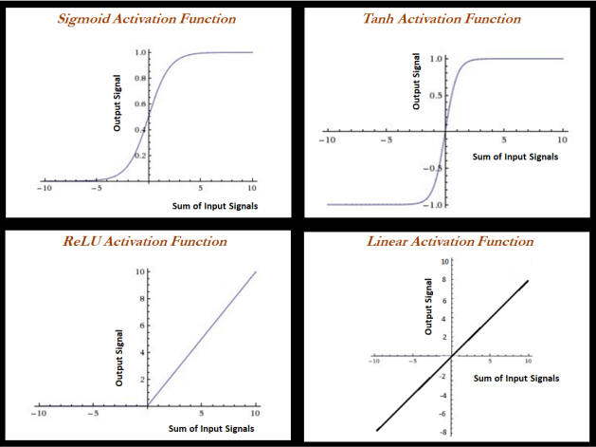
Artificial Neural Networks - ANN

Slide 46
Artificial Neural Networks - ANN
Forward propagation and backpropagation
Forward propagation and backpropagation are illustrated with the two hidden layer deep neural networks in the following example, in which both layers get three neurons each, in addition to input and output layers.
The number of neurons in the input layer is based on the number of x (independent) variables, whereas the number of neurons in the output layer is decided by the number of classes the model needs to be predicted.
For ease, we have shown only one neuron in each layer;
Weights and biases are initiated from some random numbers, so that in both forward and backward passes, these can be updated in order to minimize the errors altogether.

Slide 47
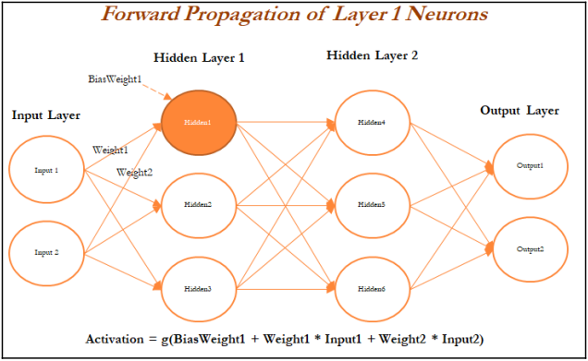
Artificial Neural Networks - ANN
Forward propagation and backpropagation
During forward propagation, features are input to the network and fed through the following layers to produce the output activation.
In the hidden layer 1, the activation obtained is the combination of bias weight 1 and weighted combination of input values; If the overall value crosses the threshold, it will trigger to the next layer, else the signal will be 0 to the next layer values. Bias values are necessary to control the trigger points.
In some cases, the weighted combination signal is low; in those cases, bias will compensate the extra amount for adjusting the aggregated value, which can trigger for the next level

Slide 48
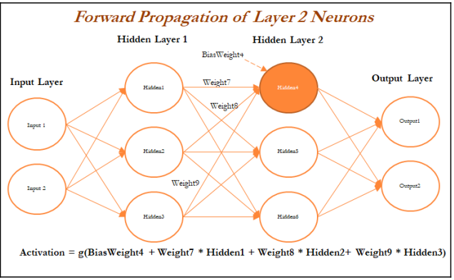
Artificial Neural Networks - ANN
Forward propagation and backpropagation
Once all the neurons are calculated in Hidden Layer 1 (Hidden1, Hidden2, and Hidden3 neurons), the next layer of neurons needs to be calculated in a similar way from the output of the hidden neurons from the first layer with the addition of bias (bias weight 4).
The following figure describes the hidden neuron 4 shown in layer 2:

Slide 49
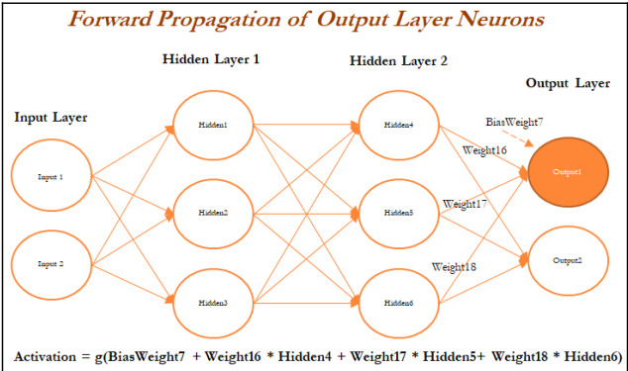
Artificial Neural Networks - ANN
Forward propagation and backpropagation
In the last layer (also known as the output layer), outputs are calculated in the same way from the outputs obtained from hidden layer 2 by taking the weighted combination of weights and outputs obtained from hidden layer 2.
Once we obtain the output from the model, a comparison needs to be made with the actual value and we need to backpropagate the errors across the net backward in order to correct the weights of the entire neural network:

Slide 50
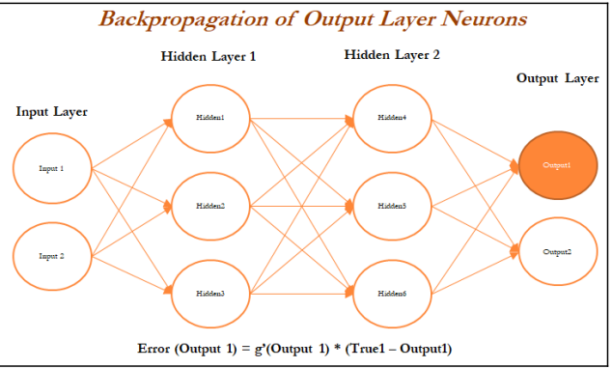
Artificial Neural Networks - ANN
Forward propagation and backpropagation
In the following diagram, we have taken the derivative of the output value and multiplied by that much amount to the error component, which was obtained from differencing the actual value with the model output:

Slide 51
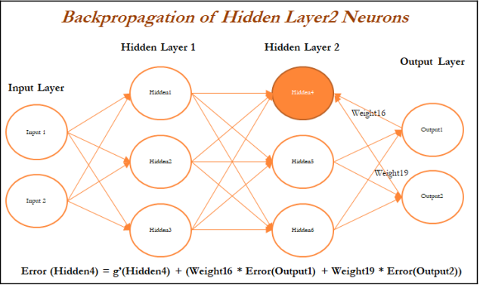
Artificial Neural Networks - ANN
Forward propagation and backpropagation
In a similar way, we will backpropagate the error from the second hidden layer as well.
In the following diagram, errors are computed from the Hidden 4 neuron in the second hidden layer:

Slide 52
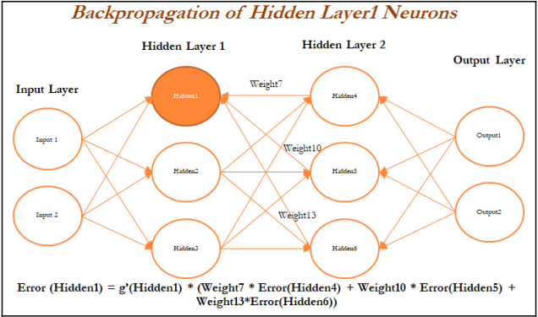
Artificial Neural Networks - ANN
Forward propagation and backpropagation
In the following diagram, errors are calculated for the Hidden 1 neuron in layer 1 based on errors obtained from all the neurons in layer 2:

Slide 53
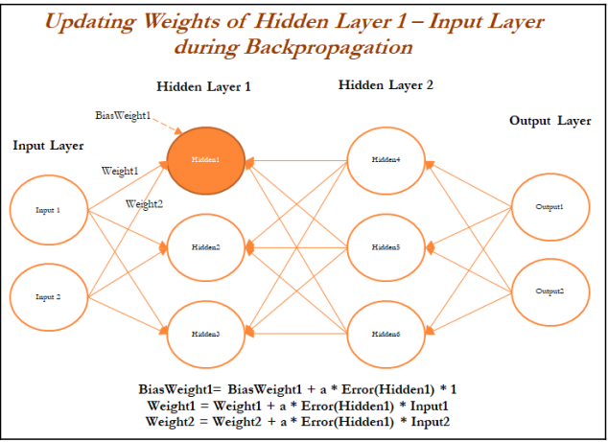
Artificial Neural Networks - ANN
Forward propagation and backpropagation
Once all the neurons in hidden layer 1 are updated, weights between inputs and the hidden layer also need to be updated,
In the following diagram, we will be updating the weights of both the inputs and also, at the same time, the neurons in hidden layer 1, as neurons in layer 1 utilize the weights from input only:

Slide 54
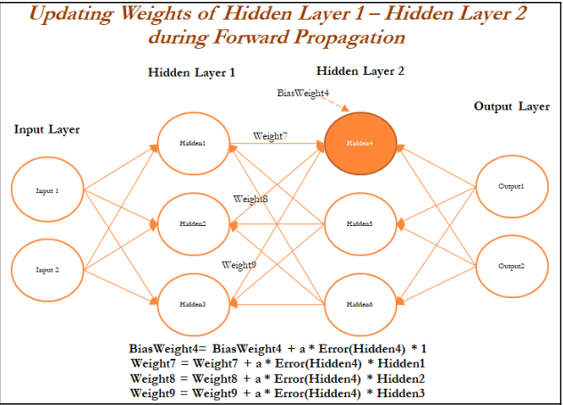
Artificial Neural Networks - ANN
Forward propagation and backpropagation
Finally, in the following figure, layer 2 neurons are being updated in the forward propagation pass:

Slide 55
Artificial Neural Networks - ANN
Optimization of neural networks
Various techniques have been used for optimizing the weights of neural networks:
Stochastic gradient descent (SGD)
Momentum
Nesterov accelerated gradient (NAG)
Adaptive gradient (Adagrad)
Adadelta
RMSprop
Adaptive moment estimation (Adam)
Limited memory Broyden-Fletcher-Goldfarb-Shanno (L-BFGS)

Slide 56
Artificial Neural Networks - ANN
Optimization of neural networks -Stochastic gradient descent - SGD
Gradient descent is a way to minimize an objective function J(θ) parameterized by a model's parameter θ ε R^{d} by updating the parameters in the opposite direction of the gradient of the objective function with regard to the parameters.
The learning rate determines the size of the steps taken to reach the minimum
Batch gradient descent (all training observations utilized in each iteration)
SGD (one observation per iteration)
Mini batch gradient descent (size of about 50 training observations for each iteration)

Slide 57
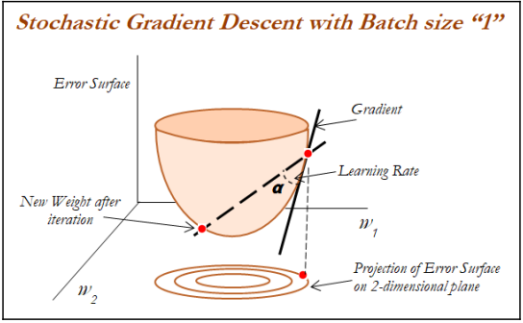
Artificial Neural Networks - ANN
Optimization of neural networks -Stochastic gradient descent - SGD

Slide 58
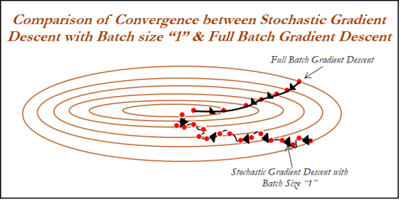
Artificial Neural Networks - ANN
Optimization of neural networks -Stochastic gradient descent - SGD
In the following image 2D projection convergence characteristics of both full batch and stochastic gradient descent with batch size 1 has been compared.
If we see, full batch updates, are more smoother due to the consideration of all the observations.
Whereas, SGD have wiggly convergence characteristics due to the reason
of using 1 observation for each update:

Slide 59
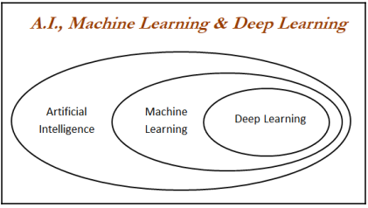
Artificial Neural Networks - ANN
Introduction to deep learning
Deep learning is a class of machine learning algorithms which utilizes neural networks for building models to solve both supervised and unsupervised problems on structured and unstructured datasets such as images, videos, NLP, voice processing, and so on:

Slide 60
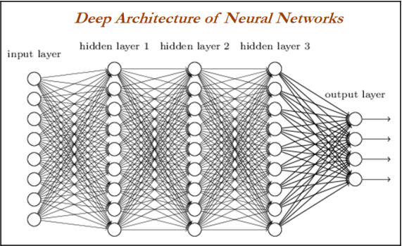
Artificial Neural Networks - ANN
Introduction to deep learning
Deep neural network/deep architecture consists of multiple hidden layers of units between input and output layers.
Each layer is fully connected with the subsequent layer.
The output of each artificial neuron in a layer is an input to every artificial neuron in the next layer towards the output:

Slide 61
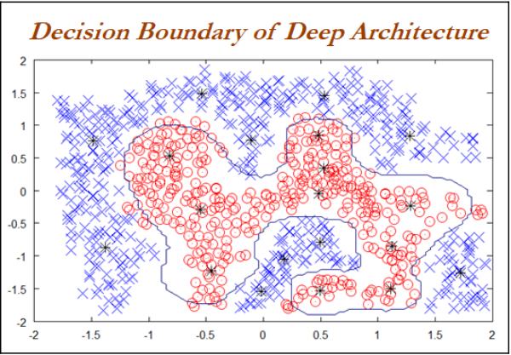
Artificial Neural Networks - ANN
Introduction to deep learning
With the more number of hidden layers are being added to the neural network, more complex decision boundaries are being created to classify different categories.
Example of complex decision boundary can be seen in the following graph:

Slide 62
Artificial Neural Networks - ANN
Solving methodology
Backpropagation is used to solve deep layers by calculating the error of the network at output units and propagate back through layers to update the weights to reduce error terms.
Thumb rules in designing deep neural networks:
All hidden layers should have the same number of neurons per layer
Typically, two hidden layers are good enough to solve the majority of problems
Using scaling/batch normalization (mean 0, variance 1) for all input variables after each layer improves convergence effectiveness
Reduction in step size after each iteration improves convergence, in addition to the use of momentum and dropout

Slide 63
Artificial Neural Networks - ANN
Deep learning software
Deep learning software has evolved multi-fold in recent times.
Different types of Deep Learning software are
Theano: Python-based deep learning library developed by the University of Montreal
TensorFlow: Google's deep learning library runs on top of Python/C++
Keras / Lasagne: Lightweight wrapper which sits on top of Theano/TensorFlow and enables faster model prototyping
Torch: Lua-based deep learning library with wide support for machine learning algorithms
Caffe: deep learning library primarily used for processing pictures

Slide 64
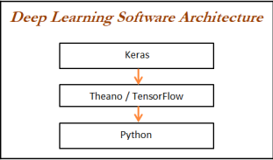
Artificial Neural Networks - ANN
Deep learning software
TensorFlow is recently picking up momentum among the deep learning community, as it is being backed up by Google and also has good visualization capabilities using TensorBoard:

Slide 65
Artificial Neural Networks - ANN
Deep learning software - Deep neural network classifier applied on handwritten digits using Keras
We are using the same data as we trained the model on previously using scikit-learn in order to perform apple-to-apple comparison between scikit-learn and the deep learning software Keras.
Data loading steps
>>> import numpy as np
>> import pandas as pd
>>> import matplotlib.pyplot as plt
>>> from sklearn.datasets import load_digits
>>> from sklearn.model_selection import train_test_split
>>> from sklearn.preprocessing import StandardScaler
>>> from sklearn.metrics import accuracy_score,classification_report

Slide 66
Artificial Neural Networks - ANN
Deep learning software - Deep neural network classifier applied on handwritten digits using Keras
Keras Library modules
>>> from keras.models import Sequential
>>> from keras.layers.core import Dense, Dropout, Activation
>>> from keras.optimizers import Adadelta,Adam,RMSprop
>>> from keras.utils import np_utils

Slide 67
Artificial Neural Networks - ANN
Deep learning software - Deep neural network classifier applied on handwritten digits using Keras
The following code loads the digit data from scikit-learn datasets. A quick piece of code to check the shape of the data, as data embedded in numpy arrays itself, hence we do not need to change it into any other format, as deep learning models get trained on numpy arrays:
>>> digits = load_digits()
>>> X = digits.data
>>> y = digits.target
>>> print (X.shape)
>>> print (y.shape)
>>> print ("\nPrinting first digit")
>>> plt.matshow(digits.images[0])
>>> plt.show()

Slide 68
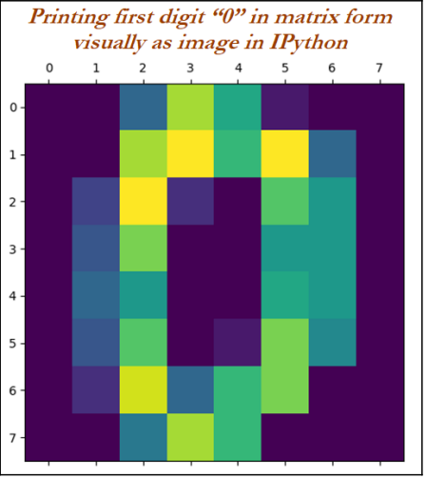
Artificial Neural Networks - ANN
Deep learning software - Deep neural network classifier applied on handwritten digits using Keras
The previous code prints the first digit in matrix form. It appears that the following digit looks like a 0:

Slide 69
Artificial Neural Networks - ANN
Deep learning software - Deep neural network classifier applied on handwritten digits using Keras
We are performing the standardizing of data with the following code to demean the series, followed by standard deviation to put all the 64 dimensions in a similar scale.
>>> x_vars_stdscle = StandardScaler().fit_transform(X)
The following section of the code splits the data into train and test based on a 70-30 split:
>>> x_train,x_test,y_train,y_test =
train_test_split(x_vars_stdscle,y,train_size = 0.7,random_state=42)

Slide 70
Artificial Neural Networks - ANN
Deep learning software - Deep neural network classifier applied on handwritten digits using Keras
We have used nb_classes as 10, due to the reason that the digits range from 0-9; batch_size as 128, which means for each batch, we utilize 128 observations to update the weights; and finally, we have used nb_epochs as 200, which means the number of epochs the model needs to be trained is 200
# Defining hyper parameters
>>> np.random.seed(1337)
>>> nb_classes = 10
>>> batch_size = 128
>>> nb_epochs = 200

Slide 71
Artificial Neural Networks - ANN
Deep learning software - Deep neural network classifier applied on handwritten digits using Keras
The following code actually creates the n-dimensional vector for multiclass values based on the nb_classes value. Here, we will get the dimension as 10 for all train observations for training using the softmax classifier:
>>> Y_train = np_utils.to_categorical(y_train, nb_classes)
The core model building code, which looks like Lego blocks, is shown as follows. Here we, initiate the model as sequential rather than parallel and so on:
#Deep Layer Model building in Keras
>>> model = Sequential()

Slide 72
Artificial Neural Networks - ANN
Deep learning software - Deep neural network classifier applied on handwritten digits using Keras
In the first layer, we are using 100 neurons with input shape as 64 columns (as the number of columns in X is 64), followed by relu activation functions with dropout value as 0.5
>>> model.add(Dense(100,input_shape= (64,)))
>>> model.add(Activation('relu'))
>>> model.add(Dropout(0.5))
In the second layer, we are using 50 neurons (to compare the results obtained using the
scikit-learn methodology, we have used a similar architecture):
>>> model.add(Dense(50))
>>> model.add(Activation('relu'))
>>> model.add(Dropout(0.5))
In the output layer, the number of classes needs to be used with the softmax classifier:
>>> model.add(Dense(nb_classes))
>>> model.add(Activation('softmax'))

Slide 73
Artificial Neural Networks - ANN
Deep learning software - Deep neural network classifier applied on handwritten digits using Keras
Here, we are compiling with categorical_crossentropy, as the output is multiclass;
whereas, if we want to use binary class, we need to use binary_crossentropy instead:
>>> model.compile(loss='categorical_crossentropy', optimizer='adam')
The model is being trained in the following step with all the given batch sizes and number of epochs:
#Model training
>>> model.fit(x_train, Y_train, batch_size=batch_size,
nb_epoch=nb_epochs,verbose=1)

Slide 74
Artificial Neural Networks - ANN
Deep learning software - Deep neural network classifier applied on handwritten digits using Keras
#Model Prediction
>>> y_train_predclass =
model.predict_classes(x_train,batch_size=batch_size)
>>> y_test_predclass = model.predict_classes(x_test,batch_size=batch_size)
>>> print ("\n\nDeep Neural Network - Train accuracy:"),
(round(accuracy_score(y_train,y_train_predclass),3))
>>> print ("\nDeep Neural Network - Train Classification Report")
>>> print classification_report(y_train,y_train_predclass)
>>> print ("\nDeep Neural Network - Train Confusion Matrix\n")
>>> print (pd.crosstab(y_train,y_train_predclass,rownames =
["Actuall"],colnames = ["Predicted"]) )

Slide 75
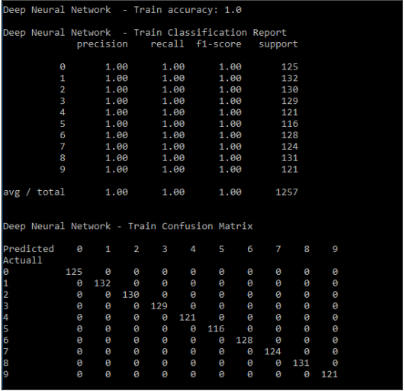
Artificial Neural Networks - ANN
Deep learning software - Deep neural network classifier applied on handwritten digits using Keras

Slide 76
Artificial Neural Networks - ANN
Deep learning software - Deep neural network classifier applied on handwritten digits using Keras
Testing
>>> print ("\nDeep Neural Network - Test
accuracy:"),(round(accuracy_score(y_test, y_test_predclass),3))
>>> print ("\nDeep Neural Network - Test Classification Report")
>>> print (classification_report(y_test,y_test_predclass))
>>> print ("\nDeep Neural Network - Test Confusion Matrix\n")
>>> print (pd.crosstab(y_test,y_test_predclass,rownames =
["Actuall"],colnames = ["Predicted"]) )

Slide 77
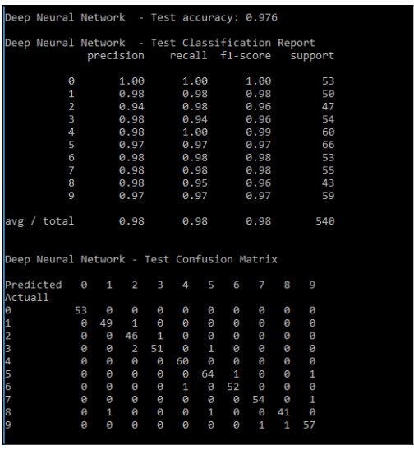
Artificial Neural Networks - ANN
Deep learning software - Deep neural network classifier applied on handwritten digits using Keras

